Slide 1
Prediction for Taipei Metro System
Data Science Final Project
Zong-Han Yang
105753024

Slide 2
Data
Cross-system ridership from 1996.3 to 2016.2
Why?
Prediction is an interesting thing.
Taipei Metro has lots of data. (21 years)
My results can be validated.
The data is still updated.

Slide 3
Data
A simple crawler to crawl the data from Taipei Metro homepage.
Clean the garbage or space cell.
Just put data from 1996.3 to 2016.2 into model.
2016.3 to 2017.2 for validation my result.

Slide 4
Model
ARIMA model
It fitted to time series data either to better understand the data or to predict future points in the series.

Slide 5
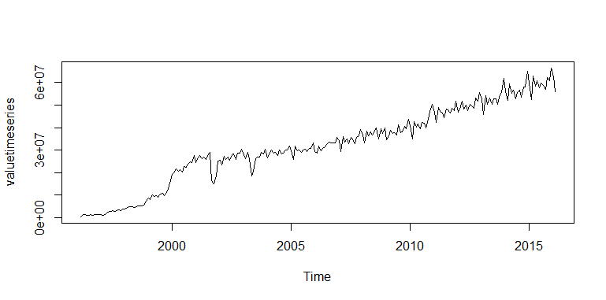
Output
This figure shows the time series.

Slide 6
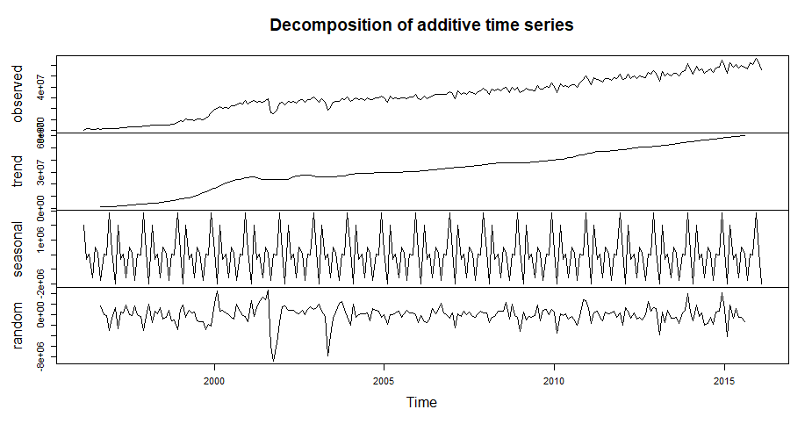
Output

Slide 7
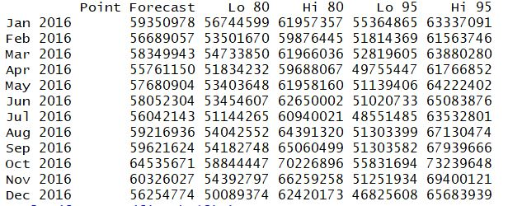
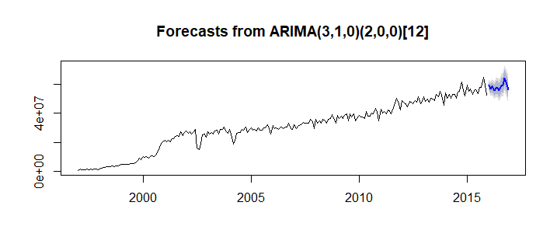
Output

Slide 8
Demo
https://zeth.shinyapps.io/final_project/

